Slide 1
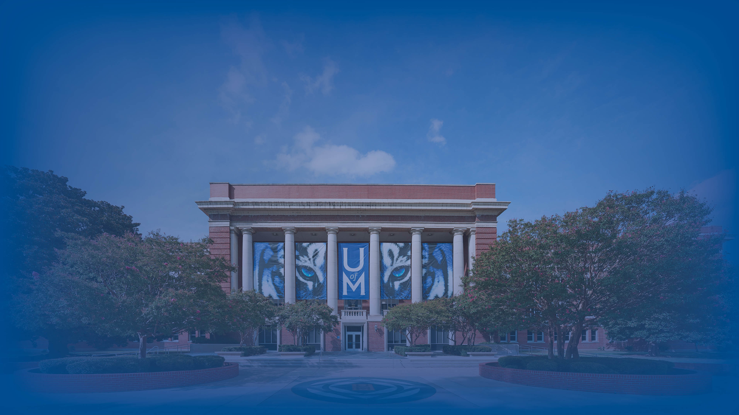
THE UNIVERSITY OF MEMPHIS
DUAL ENROLLMENT

Slide 2
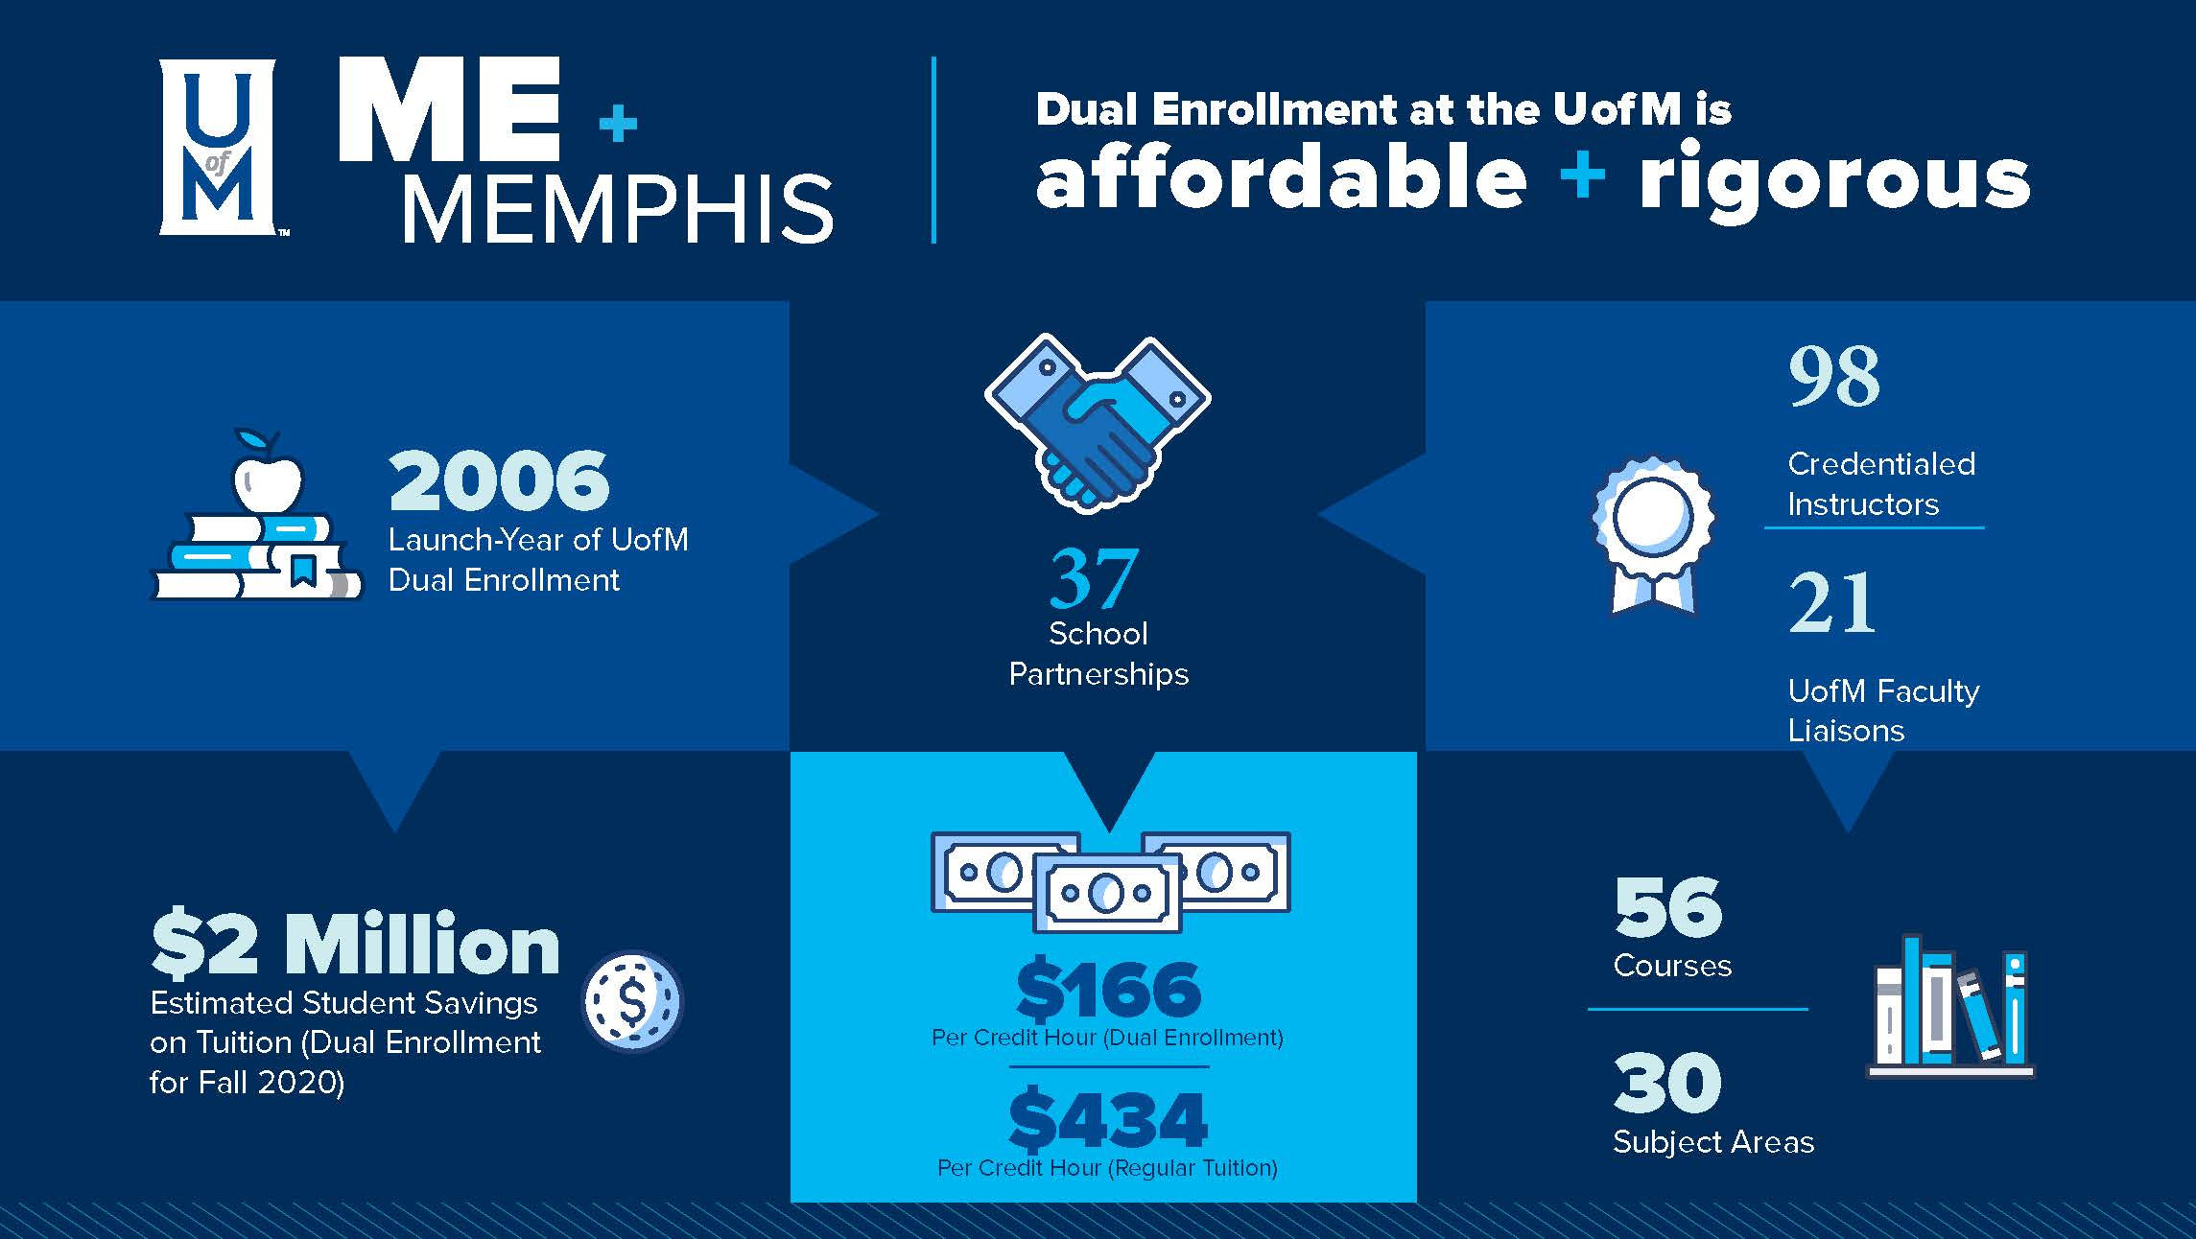
$179

Slide 3
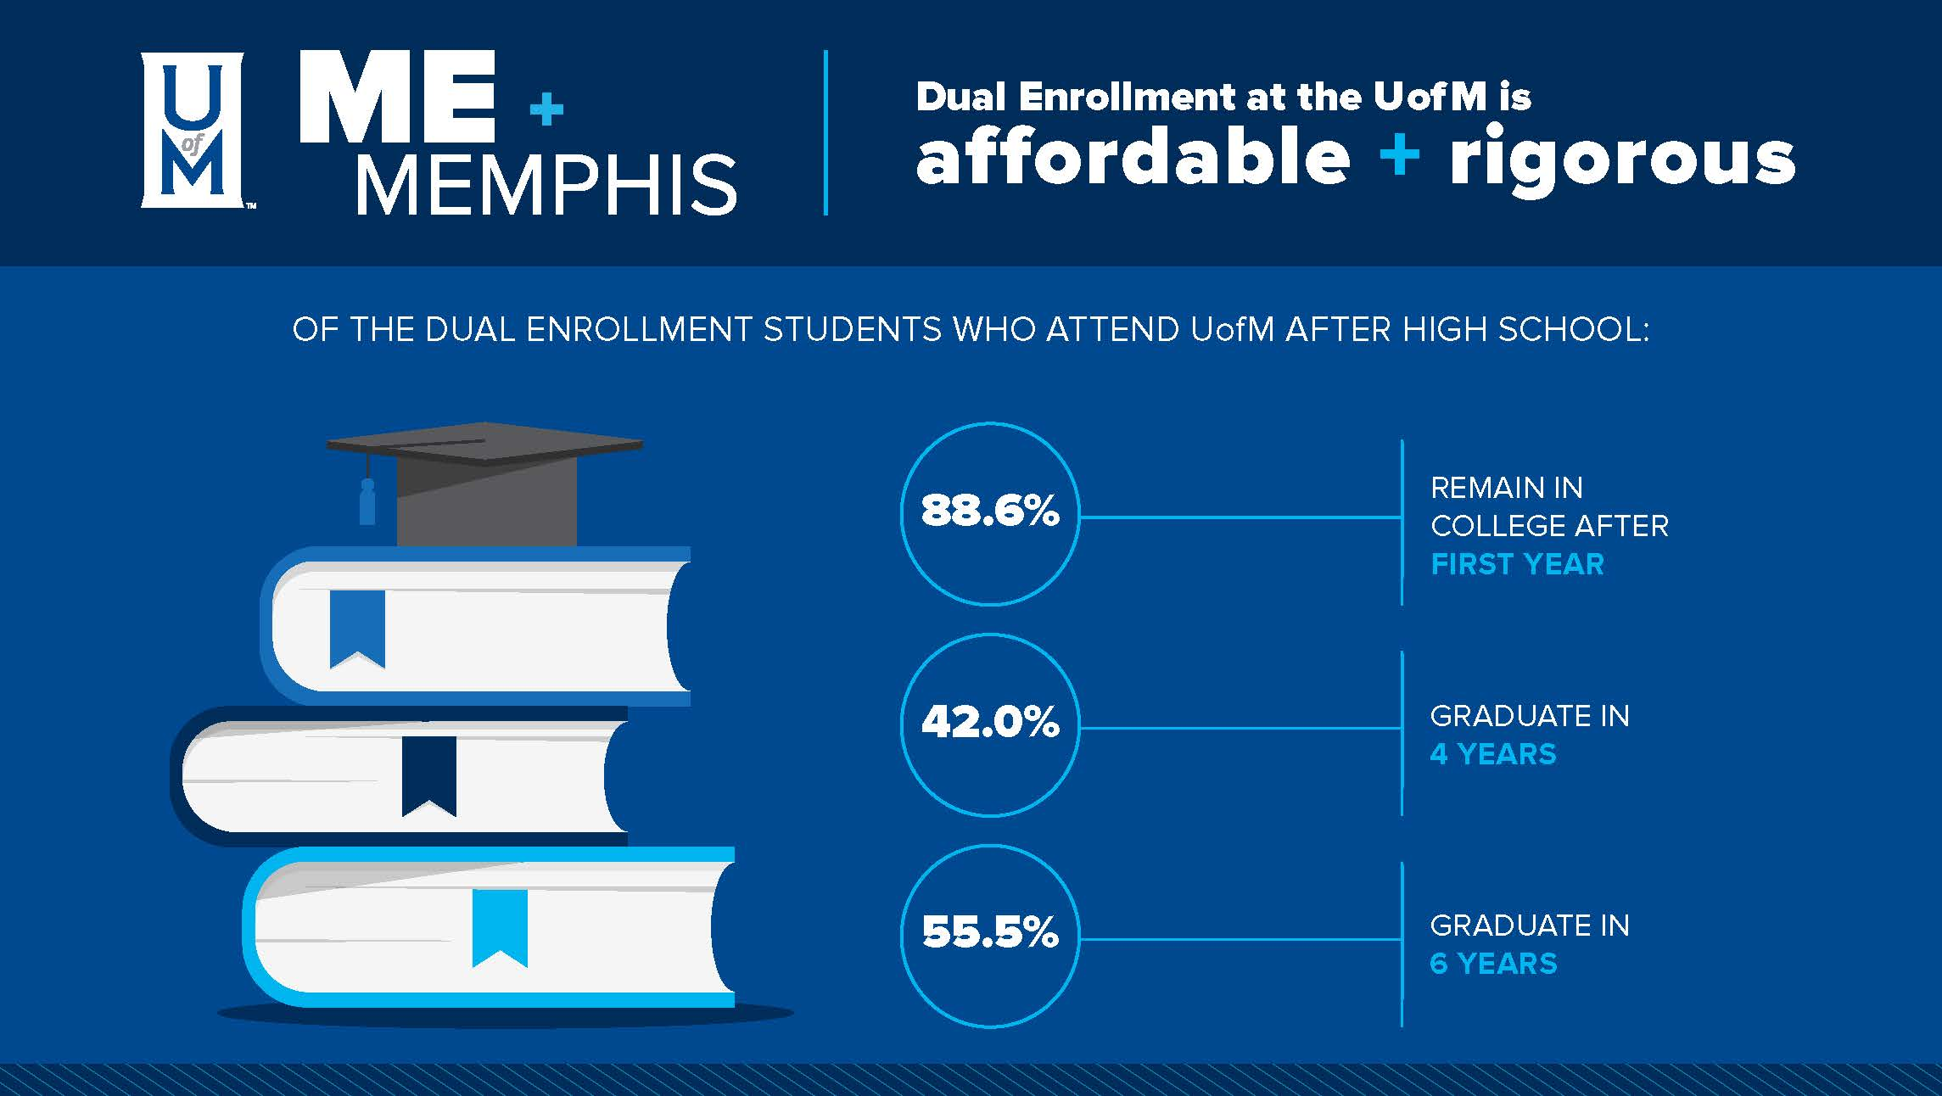

Slide 4



GET A HUGE HEAD START ON COLLEGE.
• Earn college credit and meet high school requirements simultaneously
• Knock out core college classes now, while in high school
• Tap into grants and scholarships to help cover costs
• Enjoy automatic admission to the UofM after high school graduation

Slide 5
Courses are identical to those taught at UofM
Rigor and reputation
Receive a letter grade at completion to be awarded credit
This isn’t a test-based program like AP (advancement placement)
Option to transfer earned credit to other U.S. colleges*
*Check policies with
postsecondary institutions
CURRICULUM
+
SYLLABUS

Slide 6

UofM’s Dual Enrollment
Program Admissions
To be accepted in UofM’s Dual Enrollment Program, applicants must have the following scores or higher:
19 ACT composite score
  18 English sub-score for students taking English Comp
  18 math sub-score for students enrolling in MATH 1710
  15 math sub-score for students enrolling in MATH 1530
100 admissions index score
Your high school GPA multiplied by 30, plus your composite ACT
Example: HS GPA of 2.85 x 30 = 85.5 + 19 ACT = 104.5 admissions index score
Applications are online at memphis.edu/dualenrollment
All eligible students must also submit the
TSAC Dual Enrollment Grant Application each year

Slide 7

Madison Academic Course Offerings
English
English Composition 1 (ENGL 1010)
English Composition 2 (ENGL 1020)*
Literary Heritage (ENGL 2201)*
Math
Trigonometry (MATH 1720)
Probability/ Statistics (MATH 1530)
Languages
French (FREN 1010/1020)
Spanish (SPAN 1010/1020)
History
US History to 1877 (HIST 2010)
US History since 1877 (HIST 2020)
Introduction to Psychology (PSYC 1030)
*Additional requirements must be met

Slide 8

COST
Regular tuition = $419 per credit hour
Dual enrollment reduced tuition rate = $179 per credit hour
TSAC Lottery
If eligible for grant or scholarship funds, fees come down drastically.
Your approximate cost with full TSAC grant funding and UofM institutional grant applied to classes 1-10 (~30 hours) = $0
If an in-state, UofM freshman took the exact same courses the cost would be = $12,570

Slide 9
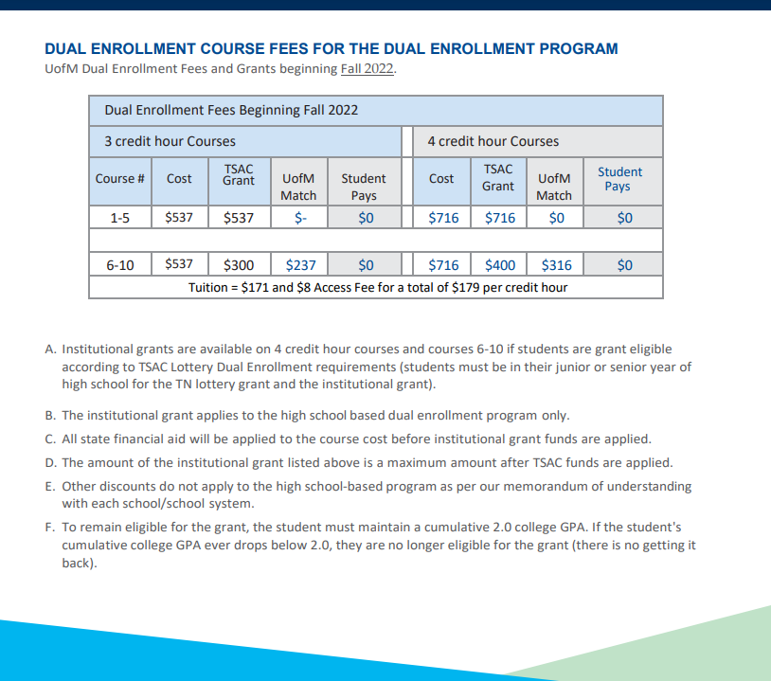

Slide 10
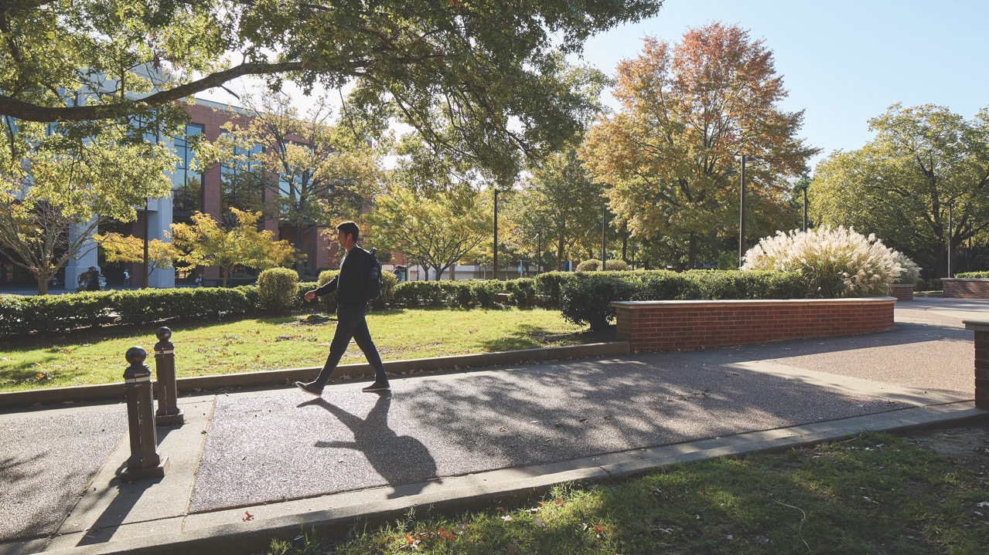
Thank you!
University of Memphis
Dual Enrollment Office dualenrollment@memphis.edu
901-678-5218

